Slide 1
USAF-558 - Supply Chain Communication
Carter Vannelli
Matthew Glos
Hao Wang
Ryan Becker
Liuhai Wang

Slide 2
Overview
Sponsor Update
Research into the problem
Research into AAR Mobility

Slide 3
Sponsor Update
01/28 - 02/03: Silence…..
02/04: Sponsor 1, Schubert, cancelled sponsorship and appointed Dangelillio
02/04: Made contact with Dangelillio
02/05: Sponsor 2, Porter, cancelled as well, Dangelillio working on getting contacts

Slide 4
What is the Problem?
KC-46 Crew in charge of loading maintaining seat pallets for KC-46 Pegasus aircraft (a military aerial refueling tanker)
Seat pallets are sourced through AAR Mobility
Cheap material that breaks often
Leads to user wanting breakdown for parts, but crucial information is missing

Slide 5
What is ETIMS?
ETIMs is a database used to store Technical Orders and Computer Program Identification Numbers
Technical Orders or TOs are military orders containing the authoritative procedures and instructions for operating and maintaining all U.S. Department of the Air Force equipment and systems
Computer Program Identification Numbers or CPINs are a unique code used to identify and manage software programs within the Air Force's technical order system

Slide 6
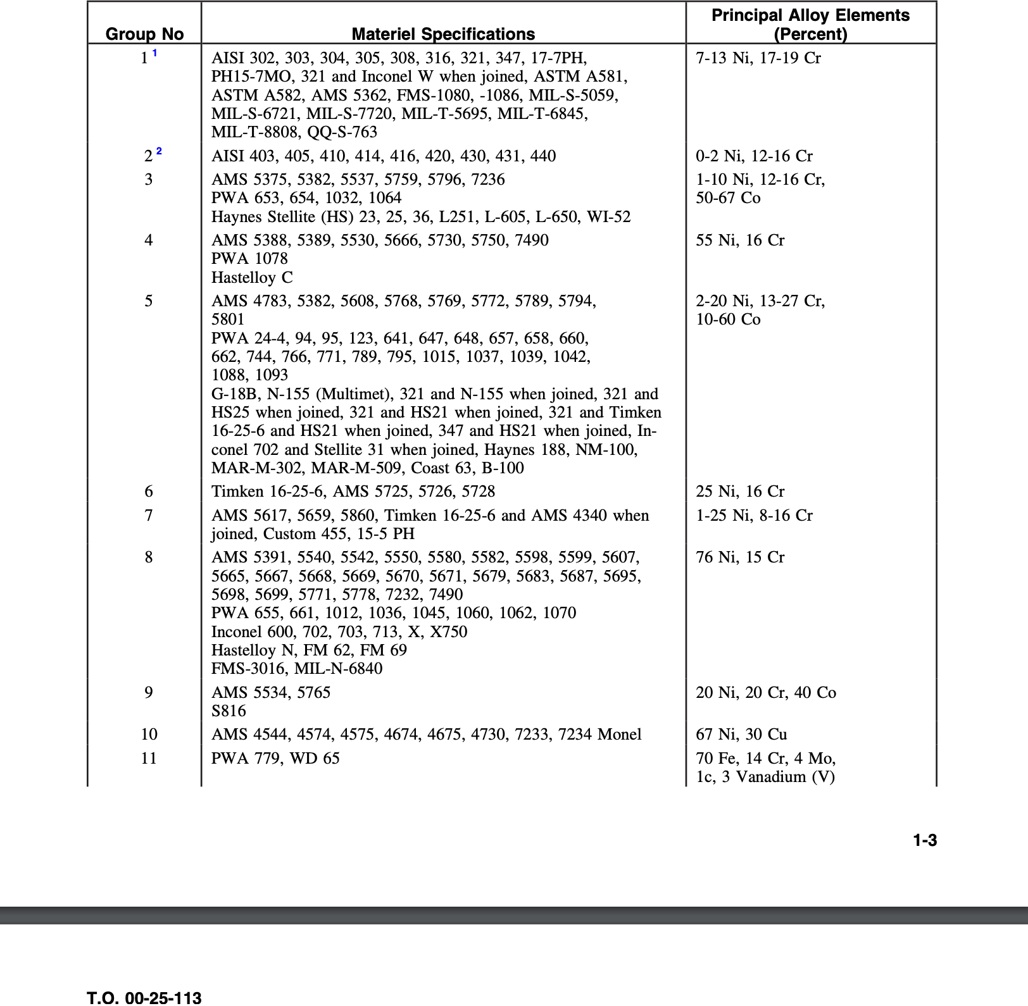
Example TO - Separating metals from parts

Slide 7

Who is AAR Mobility?
Government and commercial aviation provider
Provides maintenance services
Provides a marketplace for plane parts based on part number
Provides USAF with KC-46 seat pallets
05/15/17: AAR was given $5 mil defense contract to help with KC46 seat pallets
Notes:
https://www.aarcorp.com/en/newsroom/press-releases/2017/aar-selected-to-provide-kc-46-palletized-seating-to-u.s.-air-force

Slide 8
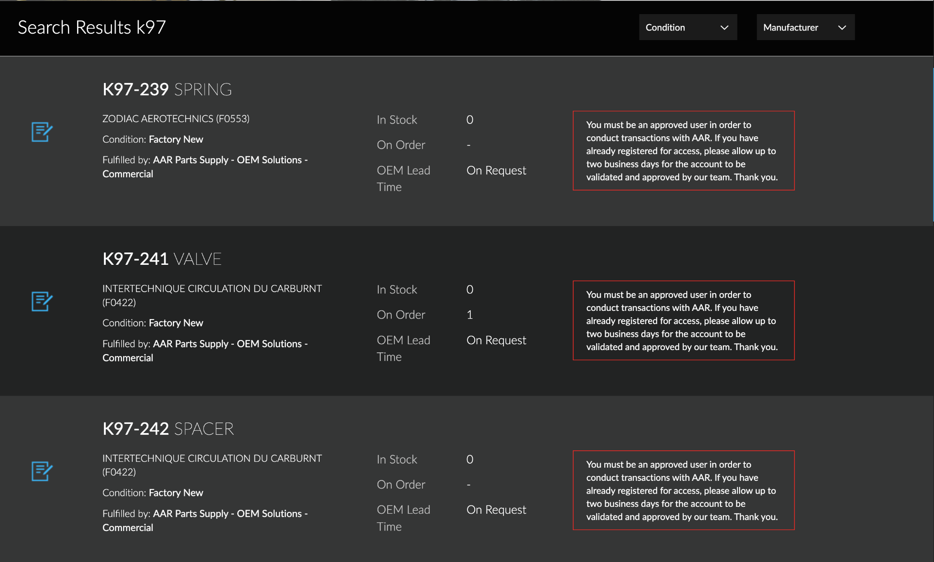
Potential AAR Catalog Image
Notes:
https://shop.aarcorp.com/catalogsearch/result/?q=k97

